Slide 1

DEPARTMENT OF INFORMATION TECHNOLOGY
Project name : Environmental monitoring
Team name :Proj_224786_team5
Team members :
jeevan siva sankar A (113321205021)
selva kumaran T(113321205046)
sabarees S(113321205301)
sridhar B(113321205051)

Slide 2
Introduction:
Environmental monitoring plays a vital role in ensuring the sustainability of our planet. With the rise in environmental concerns, the need for effective monitoring solutions has become paramount. In this context, IoT technology offers innovative ways to monitor various environmental parameters in real-time, enabling informed decision-making and environmental conservation.

Slide 3
Description:
Our environmental monitoring project focuses on real-time monitoring of key environmental parameters, including air quality, temperature, and humidity. By collecting and analyzing this data, we aim to raise awareness about environmental issues and contribute to conservation efforts. The project employs IoT technology to enable efficient data collection and analysis.

Slide 4
Objective:
Real-time monitoring of crucial environmental parameters.
Data collection for in-depth analysis and informed decision-making.
Raising awareness about environmental issues and promoting sustainable practices.
Contributing to environmental conservation efforts through actionable insights.

Slide 5
Web development technologies:
Front-end technologies: HTML, CSS, JavaScript for building user interfaces.
Back-end technologies: Node.js, Express.js for server-side scripting.
Database management: MongoDB for efficient data storage and retrieval.
Visualization: D3.js and Chart.js for dynamic data visualization.

Slide 6
Platform required:
Hardware requirements: Various sensors (gas sensors, temperature sensors) and microcontrollers (Arduino, Raspberry Pi) for data collection.
Software requirements: Integrated Development Environments (IDEs) like Arduino IDE, text editors, and necessary libraries/frameworks for coding.
Network requirements: Wi-Fi connectivity for seamless data transmission and communication with the cloud platform.

Slide 7
IoT Device Setup:
Sensors: Gas sensors for air quality monitoring, temperature and humidity sensors for climate data.
Microcontrollers: Arduino Uno for sensor interfacing and data processing.
Connectivity: Wi-Fi module for internet connectivity, enabling real-time data transmission to the cloud platform.

Slide 8
Platform Development:
Raspberry Pi is a versatile single-board computer that can be used for IoT projects. Microsoft Azure IoT offers comprehensive services and tools for building IoT applications. You can connect your Raspberry Pi devices to Azure IoT Hub, where you can manage and analyze the collected data. Azure provides various services like Azure IoT Hub, Azure Stream Analytics, and Azure Functions for building scalable and reliable IoT solutions.

Slide 9
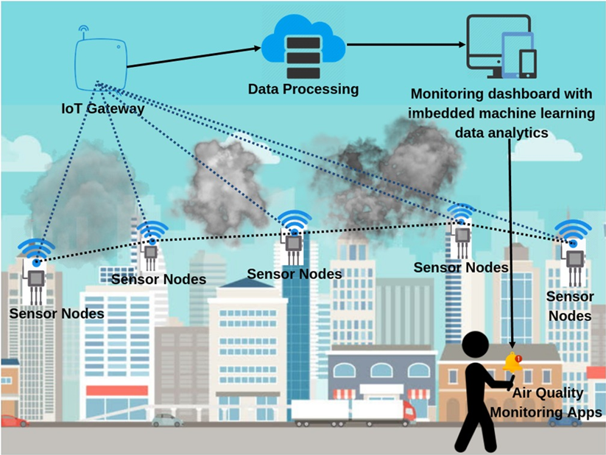
Diagram and Schematics:
Create a system architecture diagram showing how devices connect to the platform. Include schematics for the IoT devices' connectivity and power sources.

Slide 10
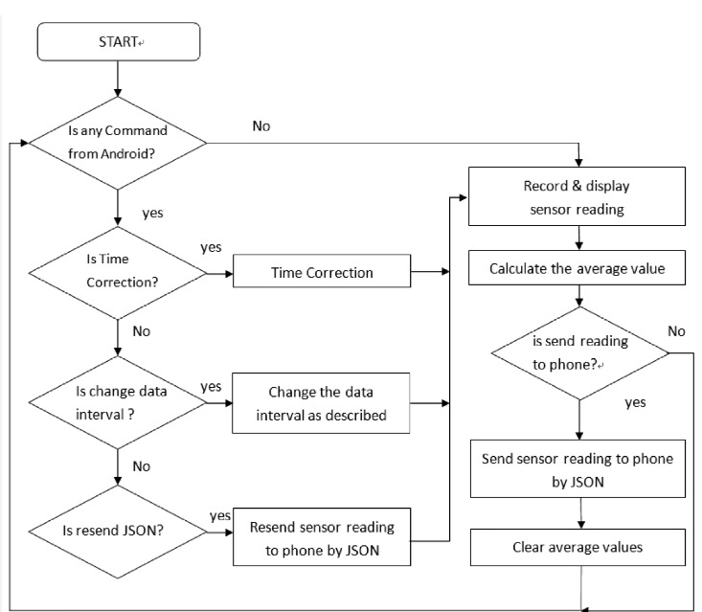
FLOW CHART

Slide 11
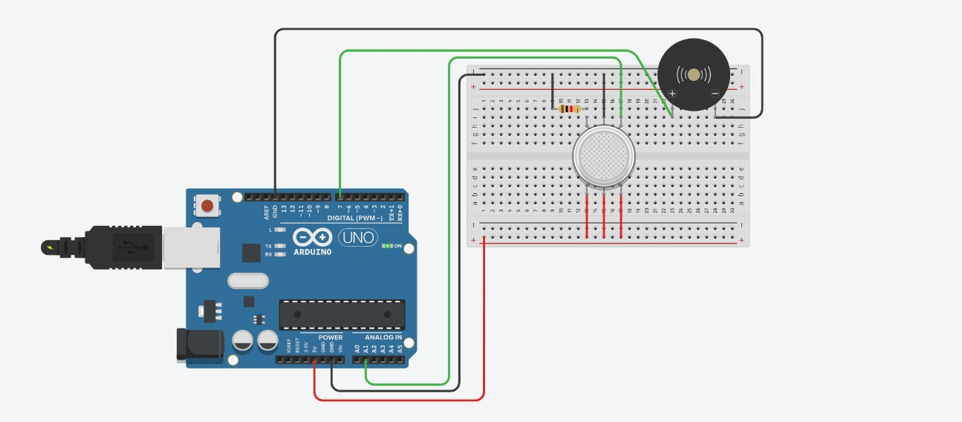
SCREENSHOTS OF THE IOT DEVICES

Slide 12
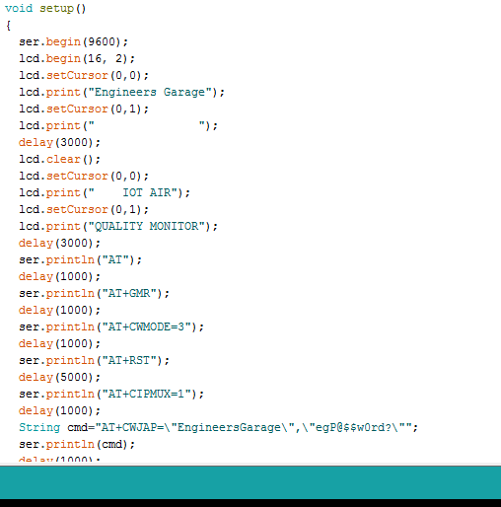
SCREENSHOT OF HTML CODE :

Slide 13
Conclusion:
Our IoT project on environmental monitoring demonstrates the power of technology in addressing pressing environmental issues. By leveraging IoT solutions, we can monitor and analyze environmental data effectively, leading to informed decisions and sustainable practices. The project's success underscores the importance of collaborative efforts in preserving our environment for future generations.

Slide 14
Thank you

